Slide 1
Machine Learning
FIFA 2018 – Match Statistics

Slide 2
Data Understanding
The dataset consists of the information about all FIFA 2018 world cup held in Russia.
The dataset comprises of
Details related to the match such as contesting teams, attempts, on-target shots, off-target shots, red/yellow flag received, corners, saves, passes, pass accuracy, goals scored, whether team won man of match.
Agenda:
Apply Machin learning algorithms on data set and predict whether team can win Man Of match based on statistcis.

Slide 3
Understand Data

Slide 4
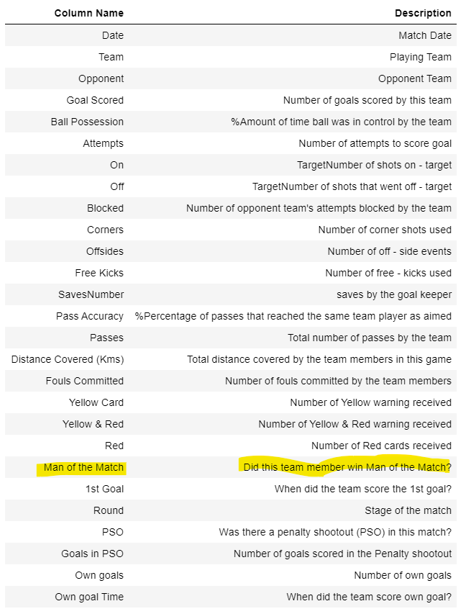
FIFA Data Set
Fifa data set consist of 128 statistics and 27 data points.
Statistics cover team, opponent, goal scored, ball possession, card, penalty shot out and other stats. Below are details.
Man of the Match is dependent variable. Aim is to predict man of the match variable based on independent variable.

Slide 5
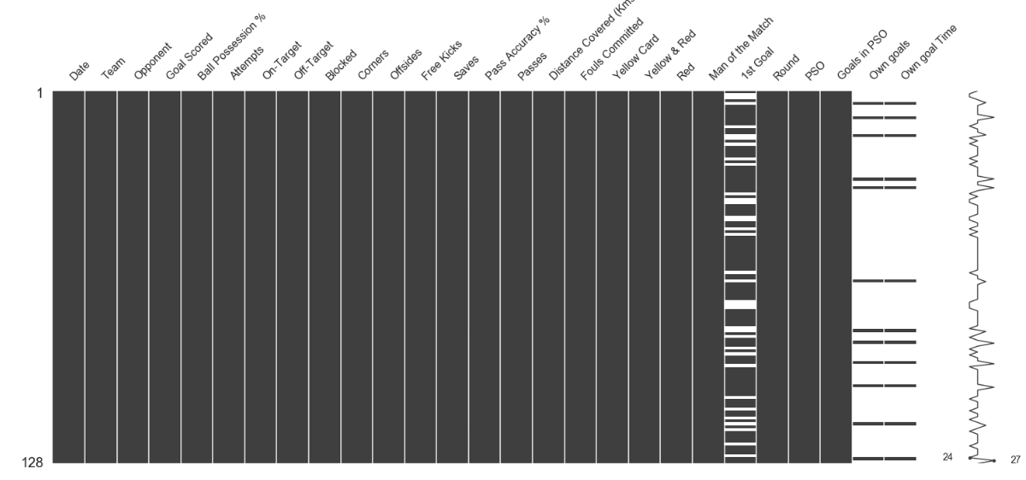
Data clean up
Notice: 1st goal, own goals and own goal time have null values.
Set "Own goals" to ZERO if empty.
Set “1st goal” to -1 if empty
Also, dummification of 'Team’, 'Opponent’, 'Round’ and 'PSO’ is required to apply ML techniques.

Slide 6
Variables Relationship

Slide 7
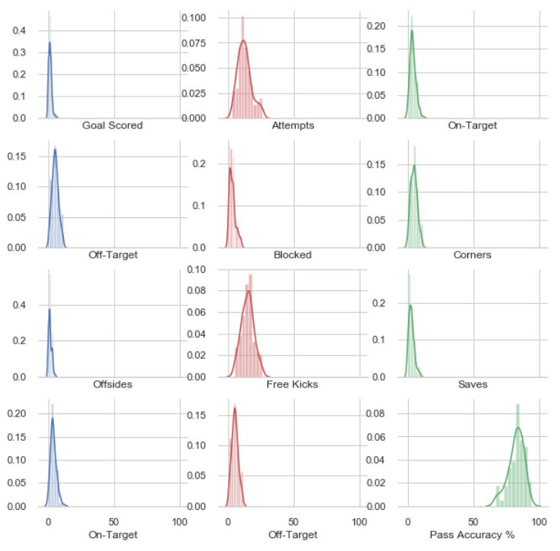
Dependent and Independent Variable Analysis
Distribution plot of independent variable shows most of variables are normally distributed

Slide 8
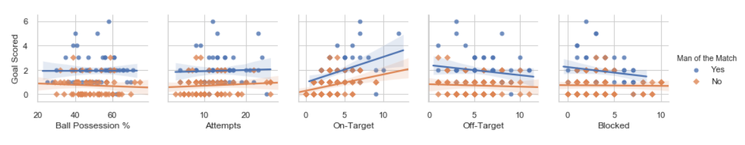
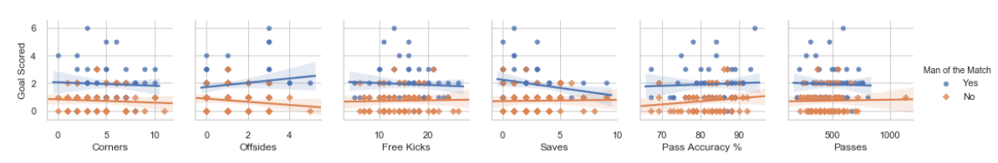
Goal Scored Vs Other Variables
Higher goals scored better are chances of team winning man of the match.
As evident from above plots Goals Scored has linear relationship with other independent variables (attempts, on-target, off-target, blocked, corners, saves, pass accuracy % and passes).

Slide 9
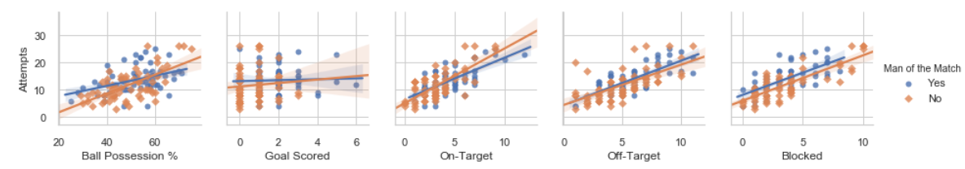
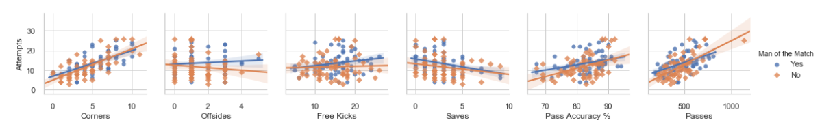
Attempts Vs Other Variables
As evident from above plots Attempts has linear relationship with other independent variables (attempts, on-target, off-target, blocked, corners, saves, pass accuracy % and passes).

Slide 10
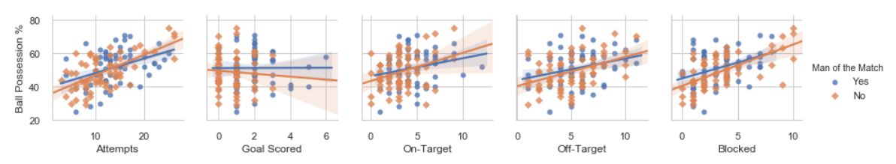
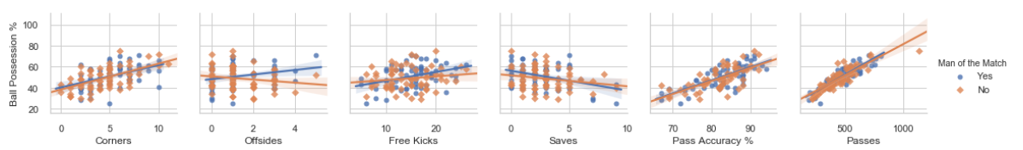
Ball Possession % Vs Other Variables
As evident from above plots Ball Possession % has linear relationship with other independent variables (attempts, on-target, off-target, blocked, corners, saves, pass accuracy % and passes).

Slide 11
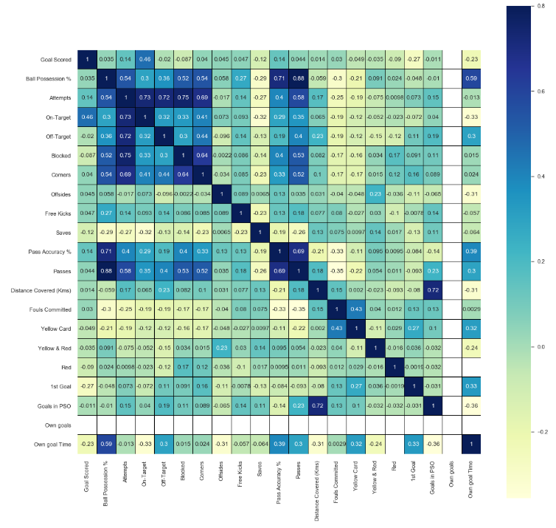
Segment over in bins and compare performance
Ball possession % has high positive correlation with Pass Accuracy %,Passes, Blocked and Corners.
- Attempts has high positive correlation with Passes, Ball Possession%, On-Target, Off-Target, Blocked and Corners.
- Ball possession % has high negative correlation with Fouls Committed and Yellow Card.
- Attempt, Pass Accuracy % and Passes has high negative correlation with Fouls Committed.

Slide 12
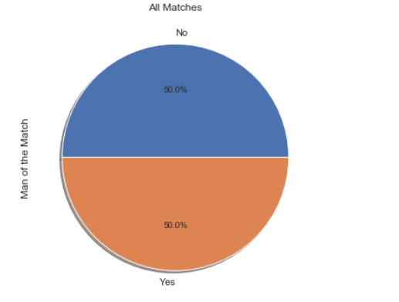
Target Variable
Target variable “Man of the Match” is equally distributed.
Model accuracy will be good measure to evaluate model performance.

Slide 13
Target Variable
Target variable “Man of the Match” is equally distributed.
Model accuracy will be good measure to evaluate model performance.

Slide 14
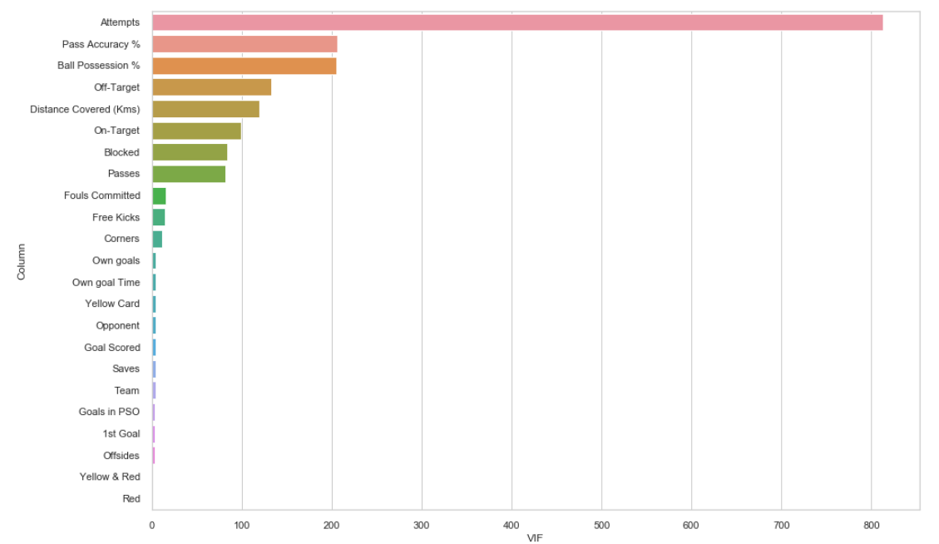
VIF – Variable Inflation Factor
Attempt, Pass Accuracy %, Ball Possession %, On-Target, Distince Covered, Off-Target, Blocked and Passes has high VIH

Slide 15
Logistic Regression

Slide 16
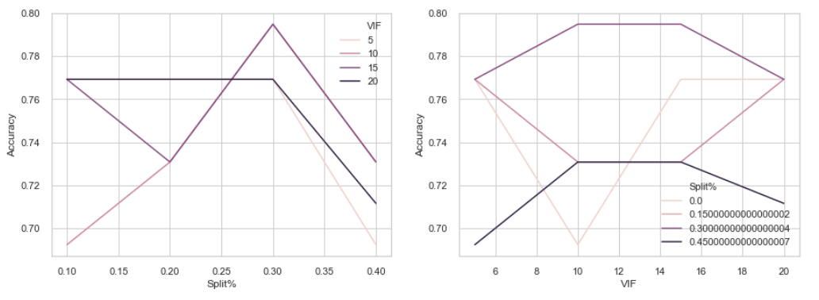
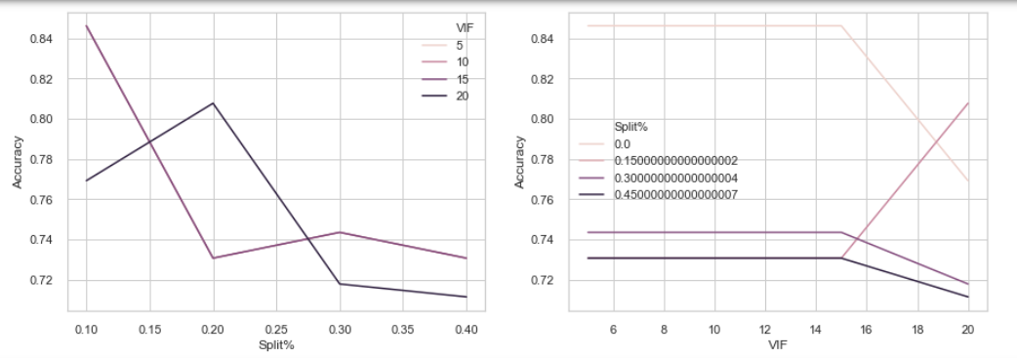
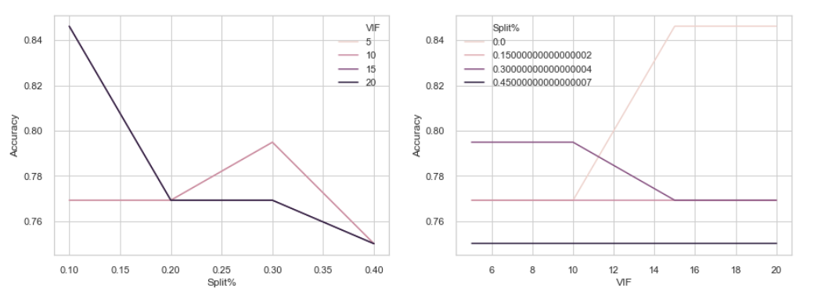
Vary independent variable and train-test split
Logistic Regression
Logistic Regression with Grid Search
Logistic Regression with Grid Search + Data Standardization

Slide 17
Conclusion
Upon applying machine learning algorithm, model is able to predict whether team will win man of the match.
Initially model accuracy was low 61%.
Grid search helped to improve model accuracy to 69%
Upon filtering independent variable by VIF (colinear independent variable) and varying test-train % model accuracy was improved to 79%
Finally applying grid search and independent variable filtering model accuracy was improved to 84%

Slide 18
Decision Tree

Slide 19
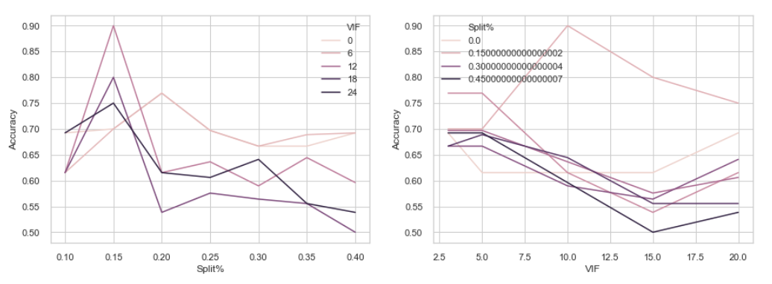
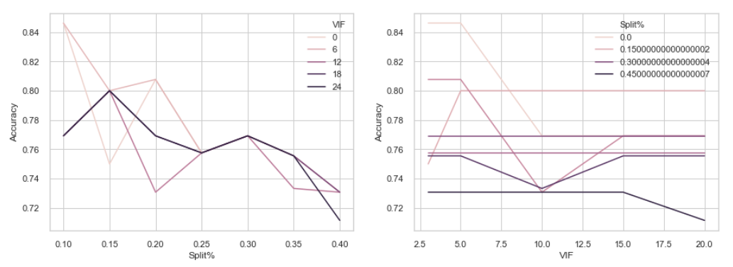
Vary independent variable and train-test split
Decision Tree
Decision Tree with Grid Search
Decision Tree algorithm model accuracy is 65%
Decision Tree algorithm with Grid Search model accuracy is improved to 76%
Upon applying Decision Tree algorithm and filtering independent variable by VIF model accuracy increased to 90%.
Upon applying Decision Tree algorithm with Grid Search and filtering independent variable by VIF model accuracy increased to 84%.

Slide 20
Random Forest

Slide 21
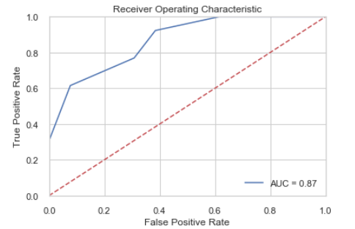
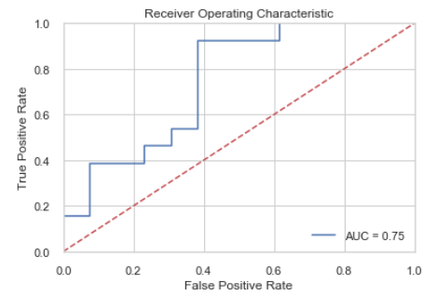
Random Forest
Random Forest model#1 accuracy is 73%
Random Forest model#2 accuracy is 76%, model#2. Model#2 has custom criteria and tree pre- pruning and post pruning parameters.
Recall score of model2 is higher, so model2 is preferable from recall point of view.
F1_score for model2 is better.
Comparing the ROC-AUC curve for both the models, model1 is better as compared to model2.
Based on model evaluation model#2 is better fit.
Criteria | Model1 | Model2
Accuracy | 73% | 76%
Precision | 75% | 70%
Recall | 69% | 92%
F1 | 71% | 80%
AUC | 87% | 75%

Slide 22
Conclusion
We applied DicisionTreeClassifer and RandomForestClassifer to predict whether team will win man of the match based on independent variables.
Target data is evenly distributed (50-50%), accuracy is good measure.
DicisionTreeClassifer based model accuracy was low 65%.
Applying gird search on DicisionTreeClassifer model accuracy improved to 76%
Upon filtering independent variable by VIF (colinear independent variable) and varying test-train % model accuracy was improved to 90%
RandomForestClassifer model accuracy varied between 73% - 76%, when model parameter was tuned.
We learned model accuracy can be improved by varying independent variable and train-test split.
Model evaluation is performed to compare model performance. Upon comparing Random Forest model by evaluating accuracy, precision, F1 and ROC-AUD it seems model2 is better as compared to model1.

